Slide 1
Intro to Unity
GameObjects
Justin Park
and Noah Poole

Slide 2
GameObjects
GameObjects are any objects that exist in the game. These include Cubes/Squares, Spheres/Circles, Sprites, Texts, and 3D Models
GameObjects

Slide 3
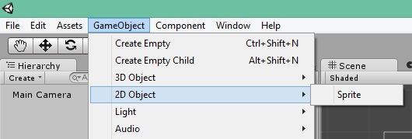
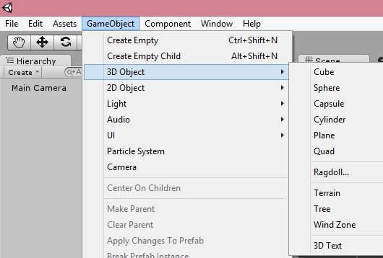
How to create GameObjects
GameObject -> 2D Object/3D Object -> Cube/Sphere/etc.

Slide 4

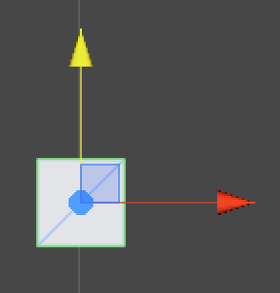

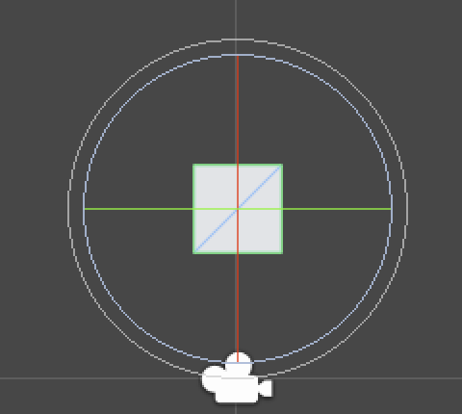

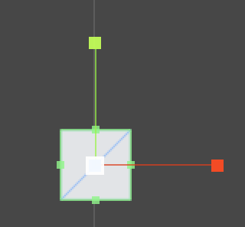
GameObject Manipulation
Move
Rotate
Move Y axis
Pull to Rotate
Move X and Y
Move X axis
Stretch
Stretch Y
Stretch Evenly
Stretch X

Slide 5
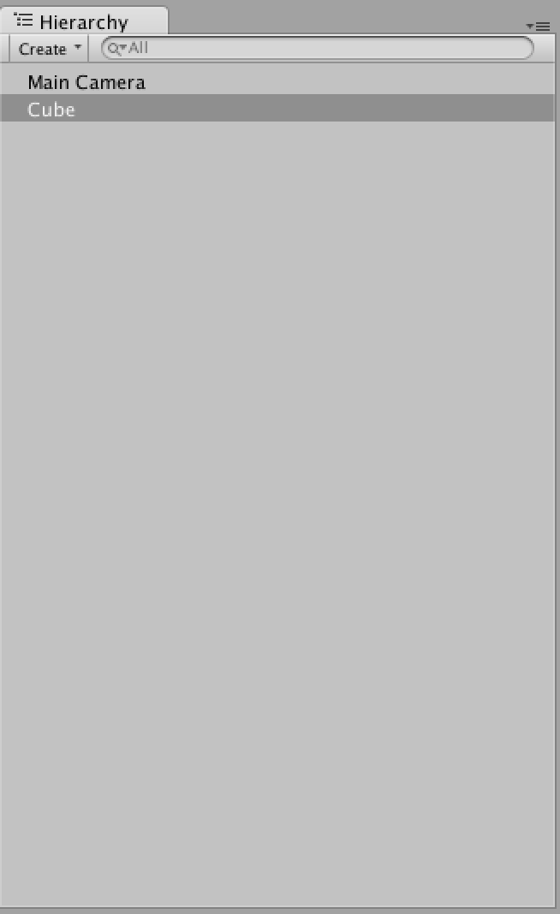
Hierarchy
The Hierarchy is the list of all GameObjects in the game scene

Slide 6
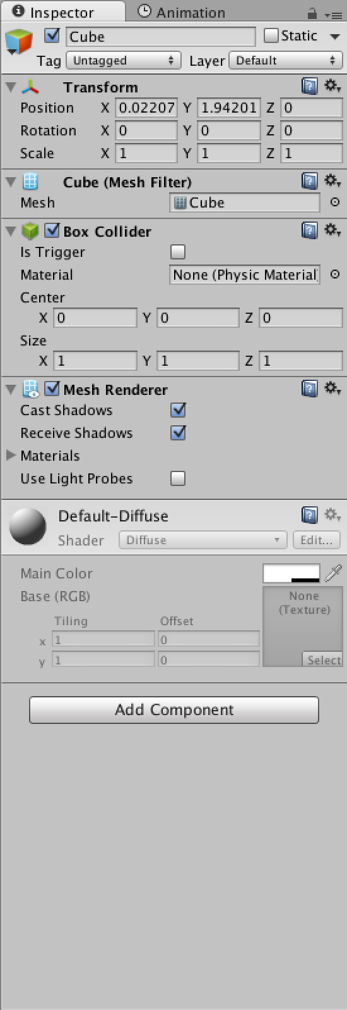
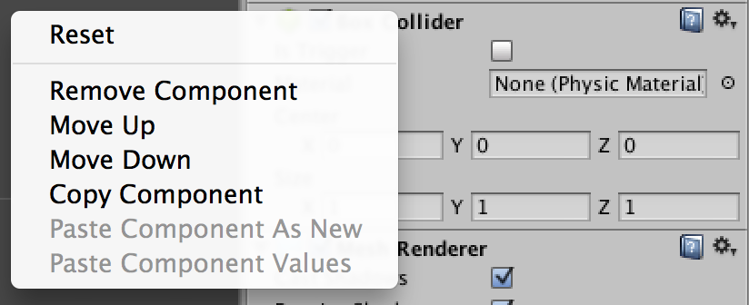
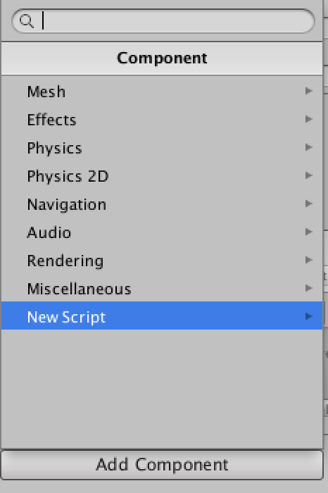
Inspector
Name of Object
Position, Rotation, and
Scale of Object
Click the check box to disable
A component
To remove a component,
Right click its name and
Choose remove component
Components
Click to add a new component

Slide 7
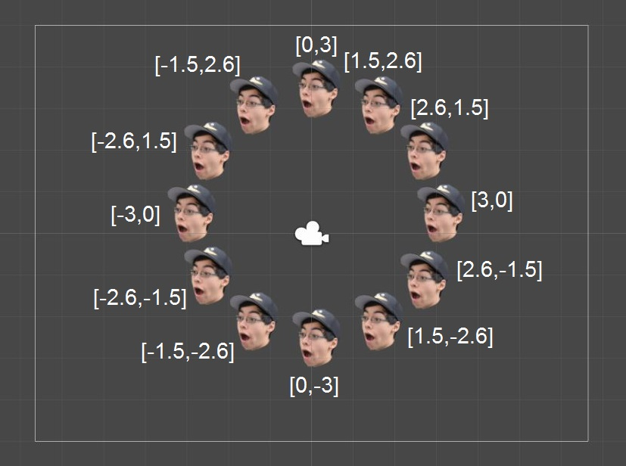
Lab
Place a copy of your sprite at each hour mark of a clock. Use the following coordinates and image for reference.

